Slide 1



Customer Care Values and methodology

Slide 2

Our culture
At Allivet we are committed to providing our customers with an exceptional experience every interaction.
There are times, though, where things don’t go as planned and our customers need our assistance. Your job is to make it right, the first time, every time.

Slide 3

OUR CORE Values
The health of our customer's pets is our primary concern
Make it effortless
Be proactive
Make it right, every time
Notes:
These are the four values that help shape the customer care culture at Allivet

Slide 4
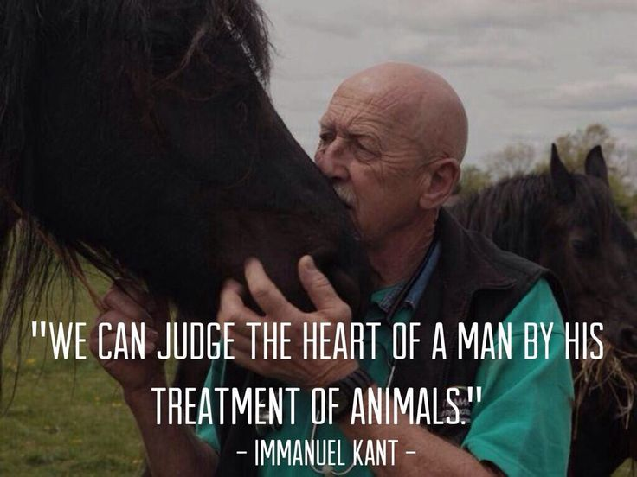
Customer Values
Pet Health
The health of our customer's pets is our primary concern:
Empathy: These animals are not just pets; they are cherished members of the family.
Urgency: Always consider the impact to the pet’s health when making decisions regarding speed of delivery.
Pharmacy Guidance: If a client believes there is an issue with the quality or condition of the medicine they received, consult with a member of our pharmacy team
Notes:
If a shipment failed to arrive and a client is out of meds we should reship expedited if necessary
The same goes for damaged or wrong shipments.
Customers have the right to request to speak to a pharmacist with questions.
When in doubt consult with a member of your management team for guidance.

Slide 5
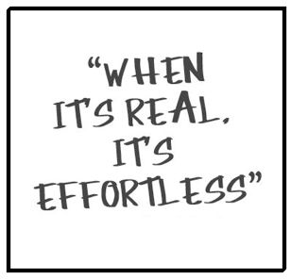
Customer Values
Make it Effortless
The best way to create a loyal customer is to resolve their issues with as little hassle to them as possible.
When a customer presents an issue to you, it is your job to take ownership of it and resolve it quickly and properly.
Part of ownership is to remove obstacles for your customers. You are the expert on Allivet and its processes, put that knowledge to work for your customers!
Notes:
Exercise:
Have the class talk about times where they had a bad experience because a company made them put in a lot of effort to accomplish a task.
How did that make them feel?
Would they use that company again if they had a choice?
How would they have felt has someone had guided them and made it easier?

Slide 6

Customer Values
Be Proactive
Every interaction with a customer involves reacting and responding to a need. It is our job to anticipate any issues before they arise so our customers will not need to contact us again.
Details: Pay attention to details on notes, prescriptions and other flags on a customer’s order that may indicate future issues.
Communicate: Relay next steps and what actions will be taken to correct any potential issues.
Follow-up: If an issue cannot be resolved right away, set up a follow up point and make sure to meet the commitment.
Proactive: One of the best ways alleviate potential issues is to be proactive.
Communicate any issues with a customer before they know about it.

Slide 7

Customer Values
Make it Right, Every Time
When dealing with our clients we will be tempted to treat them differently based on how they have treated us or some other emotional judgement.
We must approach every situation with the same goal in mind: Assess what went wrong and do everything we can to remedy it.
You have the power to fix the issue, it is your responsibility to use it.
This must be done with every contact, every day, without fail!
Notes:
Ask the team to share times they had to power to help someone and decided not to.
Why did they do that?
What was the outcome?
Would it have been easier to solve the situation and make the customer happy?

Slide 8
Methodology

Slide 9
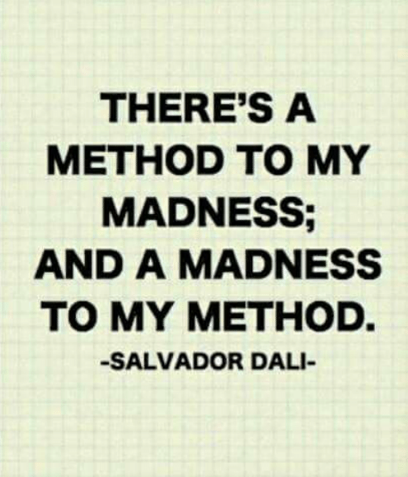
Methodology
It’s just not enough to espouse core values, they must be put into action consistently and equally.
We use the HEART method to resolve our customer’s issues. This method is similar that used by many large corporations known for being leaders in customer experience.

Slide 10





Methodology
HEART Method
Hear the Customer
Empathize
Apologize
Resolve
Take Ownership
Notes:
TRANSITIONS PER WORD

Slide 11
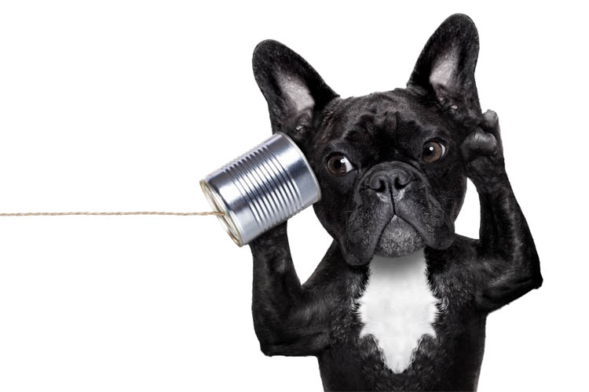
Methodology
HEART Method
Hear the Customer
The first thing that will happen with every contact is a customer wishing to communicate their issue to you.
When we are upset, we often just want someone to listen to us.
It is important to let the customer communicate the whole issue to you without interruption. The best way to do this is through active listening.

Slide 12
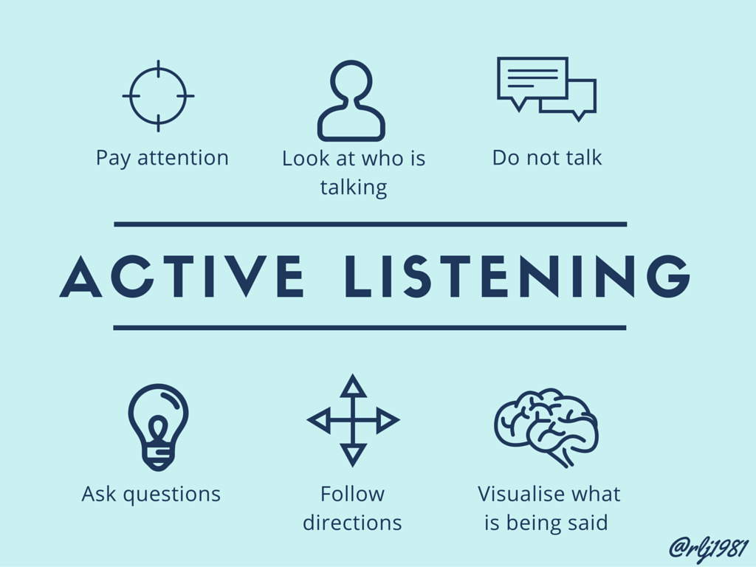
Methodology
Active Listening
Active Listening
A communication technique that requires that the listener fully concentrate, understand, respond and then remember what is being said.
Putting it into action:
Let the customer speak without interruption
Ask questions to clarify the full scope of the issue
Restate the issue to the customer in your own words to confirm understanding
Notes:
Exercise:
The telephone game (works best with 4 or more in the classroom): Whisper a message to the first student and have them whisper it to the next person and so on. Have the last person say what they were told. Use this to relate to the reps how we perceive each other’s communication differently and this illustrates why it is important we confirm our understanding with our customers.

Slide 13

questions
Asking the right questions is important to get the information you need.
If the situation is simple, short questions that illicit short answers will work best to get to the root of the matter.
In more complex situations we should use open ended questions that allow customers to provide a narrative of the issue. Once we have the big picture, we can use closed ended questions to refine our understanding.

Slide 14

questions
Closed Ended Question
Examples of closed ended questions:
When did you fax your prescription?
Is the medicine meant for Rocky or Fluffy?
Was there any damage to the package?
How much does your pet weigh?
Do you want this shipped overnight?

Slide 15
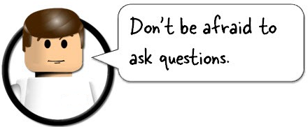
questions
Open Ended
Examples of open-ended questions:
What treatment did the vet recommend for your dog?
What reaction did Mr. Pickles have to the Vetmedin?
What can I do to correct this situation for you?

Slide 16
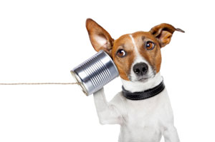
Methodology
Active Listening
Restate the issue
Once you have the necessary information, it is important that you restate the issue to the customer to communicate your full understanding
Avoid parroting the customer’s own words whenever possible, it’s best done in your own voice.
Notes:
Exercise:
Break up in small groups and have the agents take turns telling each other about what they did last weekend. The person listening should be asking clarifying questions along the way and at the end should be able to provide an accurate synopsis of their partners weekend. Have them rate each other on how well they did. Watch for body language that shows engagement with each other.

Slide 17
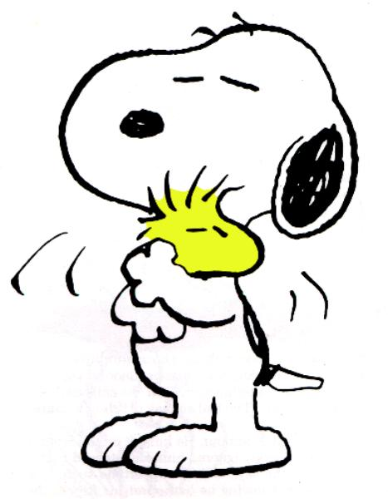
Methodology
Empathy
Empathy
Empathy is the ability to understand and share the feelings of others.
To better understand our customer’s concerns, we want to put ourselves in their position. Acknowledging how a person feels and sharing concern for their issue is one of the most important things we can do to personalize our service.
This is not to be confused with sympathy which is showing pity or sorrow for others.

Slide 18
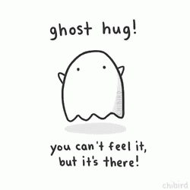
Methodology
Empathy Statements
Expressing Empathy
Simple expressions will let the customer know you understand how they are feeling:
“I can see why you would be frustrated.”
“If that happened to me, I would be upset too.”
“You are absolutely correct, [customer name]
I am sorry to hear [pet name] passed away, it’s always tough to lose a cherished member of the family.
Empathy may be listed as the second step in this process, but it should be expressed throughout the entire contact!
Notes:
The first two statements are good to relate to a frustrating situation
The third statement is best used when a customer is expressing dissatisfaction with an obvious mistake on our part. Affirming they are correct is the first step to calming them down and winning them over.
The last statement is an example of how to address the passing of a pet.
Exercise:
Give students scenarios and have them respond using their own empathy statements.

Slide 19
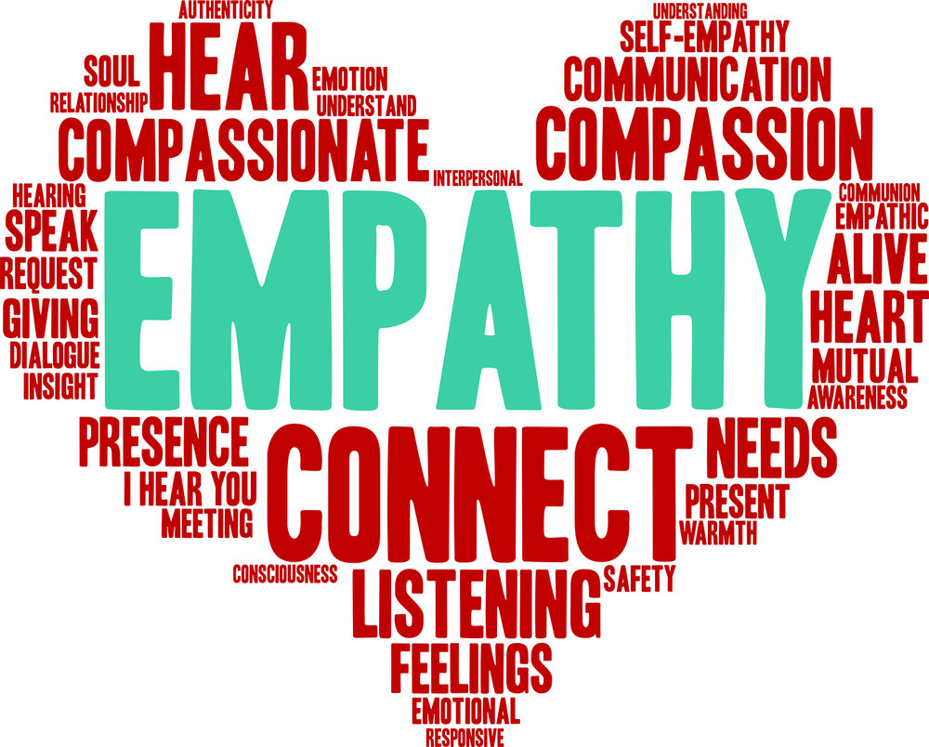
Expressing Empathy
Empathy Tips
Acknowledge a person and their pets by their respective names
Smile! It comes through over the phone.
Use the proper tone and inflection to convey your emotion. Flat and monotone speech will make the customer feel disinterested.
Most importantly be genuine!
Notes:
Exercise:
Give students scenarios and have them respond using their own empathy statements and give them feedback.

Slide 20
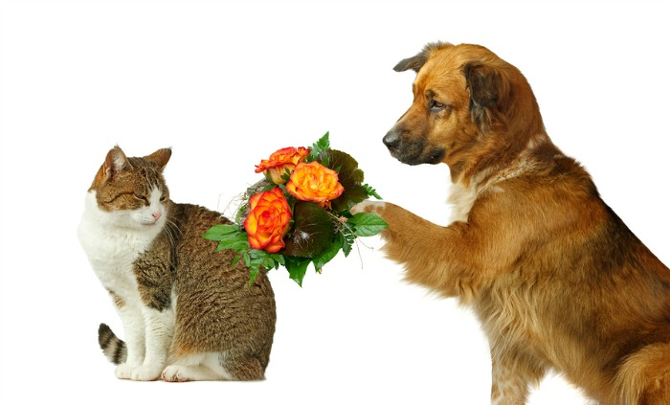
Methodology
Apologize
Value of an Apology
Acknowledging fault is a powerful way to let customer know they are right and that you understand their perspective. It shows that you have a shared reality with the customer and removes the defensive barriers that tend to exist in these conversations. Overall, it’s the first step in conveying ownership on the issue.
**Studies have shown that an apology can be twice as effective as monetary compensation at satisfying customers and keeping their future business. **
Notes:
Arizona State University School of Business conducted a study that showed an when a customer was offered and apology along with compensation they were satisfied with the outcome 74% of the time vs. 37% who were just offered compensation.

Slide 21

Methodology
HEART Method
Apologize
Apologies should be sincere and convey understanding of the customers issue.
Apologies should be made in the first person. (I vs. we or they)
You do not always have to agree with everything a customer says but, a minimum, you should acknowledge their feelings on the issue.
i.e.: I am very sorry that we made you feel that way
We should also communicate what we will do differently to avoid the situation in the future.
Notes:
Notes:
Arizone

Slide 22

Expressing Empathy
How to Apologize
How not to Apologize
Don’t make promises you can’t keep
Don’t trivialize or ignore the customer’s feelings
Don’t defend yourself by blaming someone else or minimizing the problem.
Don’t over apologize.
Notes:
Examples:
“I’m sorry, this will never happen again!” we have no way to ensure anything with 10% certitude.
“Our other customers haven’t experienced that” or “That couldn’t have happened.”
Don’t blame other departments or the company who shipped the item. Don’t tell customers something isn’t a big deal, they are calling us so it is a big deal to them. Bottom line is we are here to represent the company and it’s processes on the whole and we must take ownership. IE “I’m sorry you didn’t get your package but we can’t control the Post Office.”
Simple direct apologies work best. When we say sorry too often it loses it’s value.
Exercise:
Present situations to the class and have them respond with an appropriate apology. They should be displaying the first three steps of the HEART method when doing so.

Slide 23
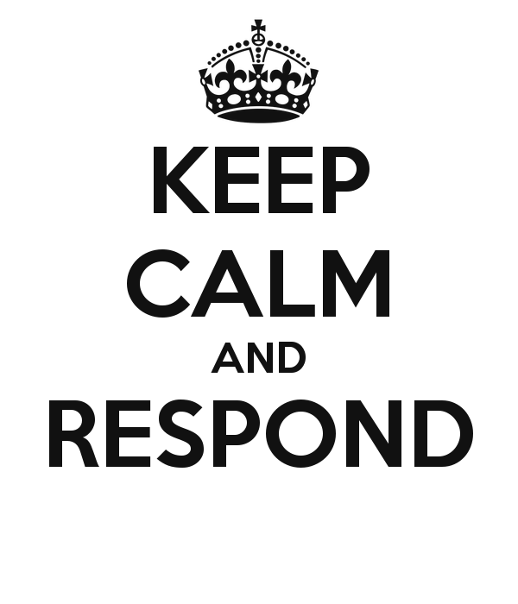
Methodology
Resolve the Situation
Resolve the Customer’s Issue
Now that you understand the situation, you need to respond with the appropriate solution. We need to take the appropriate action to fix the issue and offer the right resolution to satisfy the customer.
Re-ship
Refund
Discount
Contact vet
Etc.
If you or your manager are unsure of the correct resolution, ask the customer:
“What can I do to make this right?”
Even if the request is unrealistic it will allow the customer to set their expectations.

Slide 24
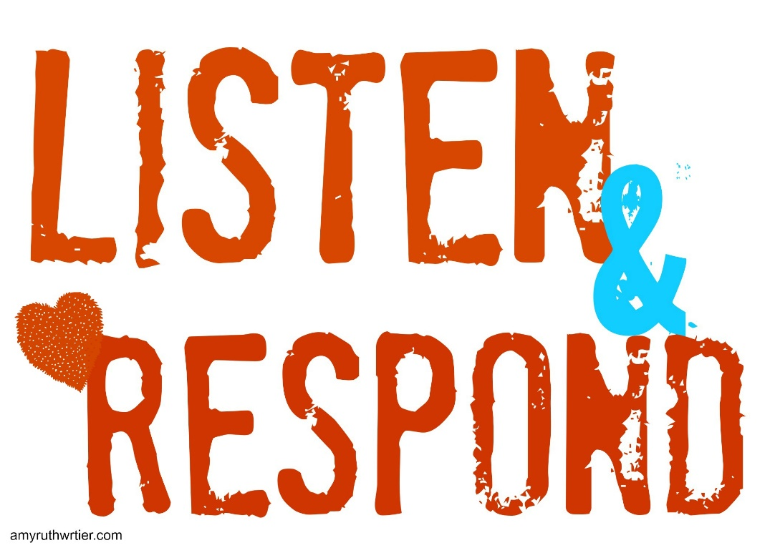
Methodology
HEART Method
Communicating the Resolution
Once you know what needs to be done, you need to communicate your resolution to the customer.
Be clear and concise with what actions you will take. Explain what the next steps will be, communicate potential obstacles and what we will do to resolve them.
By explaining what you are doing you are involving the customer and showing that you intend to make it right. Your actions will help bridge the gap between their current dissatisfaction and where you want them to be.

Slide 25

Methodology
HEART Method
Resolution: Taking Action
Actions speak louder than words. Once you have told the customer what you will do, you must ensure that it is done. Instead of putting the customer on hold, communicate with them as you are going through the steps to fix the issue. This will give them comfort in that the issue is being addressed
If you are unable to immediately provide the resolution, advise the customer what the follow up time frame should be.

Slide 26

Methodology
Taking Ownership
Taking Ownership
The most important aspect of this process is to take ownership of the issue. It is your responsibility to see the resolution through to the end.
Let the customer know you will be the one to solve their issues
Keep your commitments to the customer
Notify them of any changes or set- backs before they reach out to you
Follow up to make sure the issue was resolved.

Slide 27

Methodology
Action phrasing
Action Phrasing
These are words that convey ownership and action to the customer. They talk about what you are going to do and what you can do.
They are generally verbs or phrases that frame an action you will personally take in a positive way. We should speak definitively not vaguely.
These almost always include the words “I can” or “ I will”

Slide 28
Methodology
Action phrasing Continued
Examples of Action Phrases:
I will be glad to help you with that . . .
Here is what I can do for you . . .
I can see how you feel that way . . .
I understand your concern, here is what I will do to help . . .
I’m sure I can get that fixed for you . . .

Slide 29

Methodology
Pleasantries
Pleasantries
When providing excellent customer service, one cannot overlook the power of simple pleasantries.
Use a customer's name when appropriate
Say please when asking a customer to do something or before putting them on hold
Thank a customer when they give us information or after coming back from a hold.

Slide 30
Methodology
Pleasantries
Examples of Pleasantries
May I please have your e-mail address?
May I please place you on a brief hold?
Hi John, Thank you for holding . . .
Thank you for [X] information, please allow me a moment to look into this.
Notes:
Being pleasant, polite and taking ownership of a problem will go a long way in winning over the most difficult customers.

Slide 31

Methodology
PUTTING IT ALL TOGETHER
PUTTING IT ALL INTO ACTION
Now that you have learned our customer service values and methodology it is time to put in into practice!
Roleplay situations with your class mates and instructor to practice these methods until they become second nature.
Notes:
Being pleasant, polite and taking ownership of a problem will go a long way in winning over the most difficult customers.

